Slide 1

DEAN ACCESS ROLE
FOPPS ONLINE CLASS PORTAL
https://fopps-uok.online/
FACULTY OF PHARMACY AND PHARMACEUTICAL SCIENCES SOFTSOLS PAKISTAN

Slide 2

FOPPS-UOK.ONLINE PAGE
FACULTY OF PHARMACY AND PHARMACEUTICAL SCIENCES SOFTSOLS PAKISTAN

Slide 3
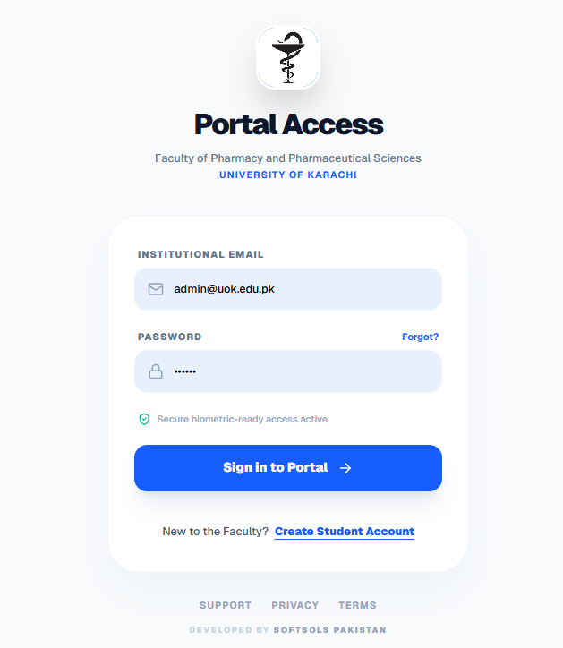
LOGIN PAGE
The Login page of Portal is Sign-In Access
Login to Portal to access by inserting:
Email Address
Password
Click Sign In to get access

Slide 4
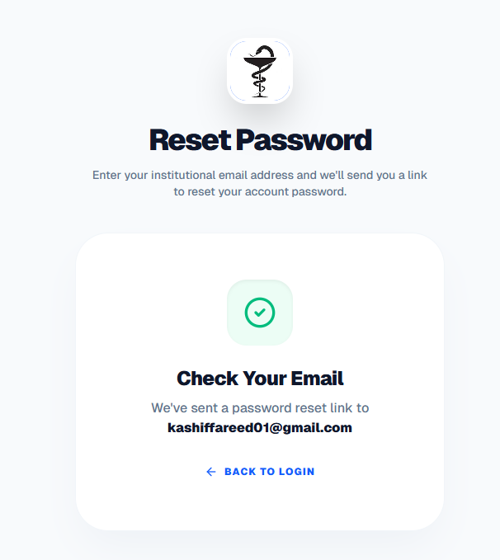
Reset Password
The confirmation message shown on screen for Password Link Sent to the respective Email Address
FACULTY OF PHARMACY AND PHARMACEUTICAL SCIENCES SOFTSOLS PAKISTAN

Slide 5
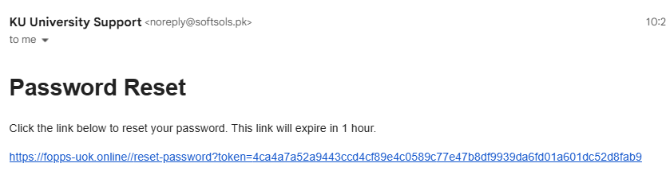
Email Received for Reset Link
FACULTY OF PHARMACY AND PHARMACEUTICAL SCIENCES SOFTSOLS PAKISTAN

Slide 6
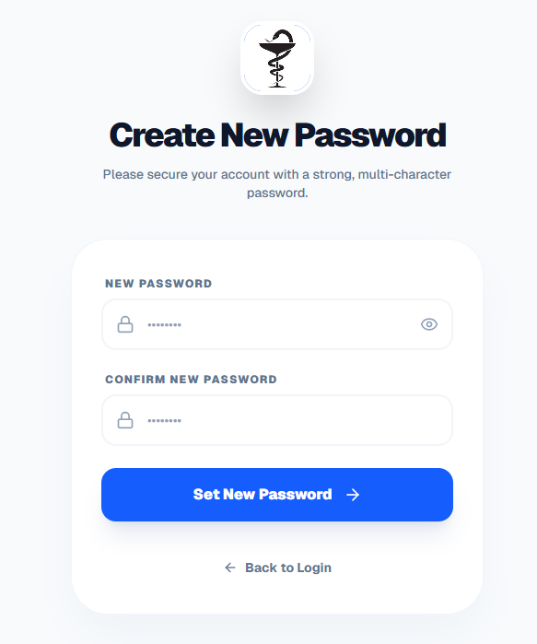
Reset Password
You will choose new password.
FACULTY OF PHARMACY AND PHARMACEUTICAL SCIENCES SOFTSOLS PAKISTAN

Slide 7
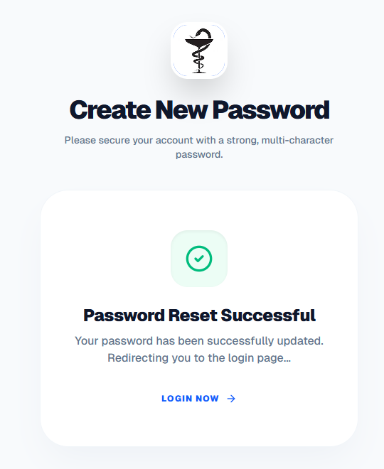
Reset Password
Confirmation on Screen about Password changed.
You will login with New Password.
FACULTY OF PHARMACY AND PHARMACEUTICAL SCIENCES SOFTSOLS PAKISTAN

Slide 8
LOGIN PAGE
The Login page of Portal is Sign-In Access
Login to Portal to access by inserting:
Email Address
Password
Click Sign In with new password to get access

Slide 9
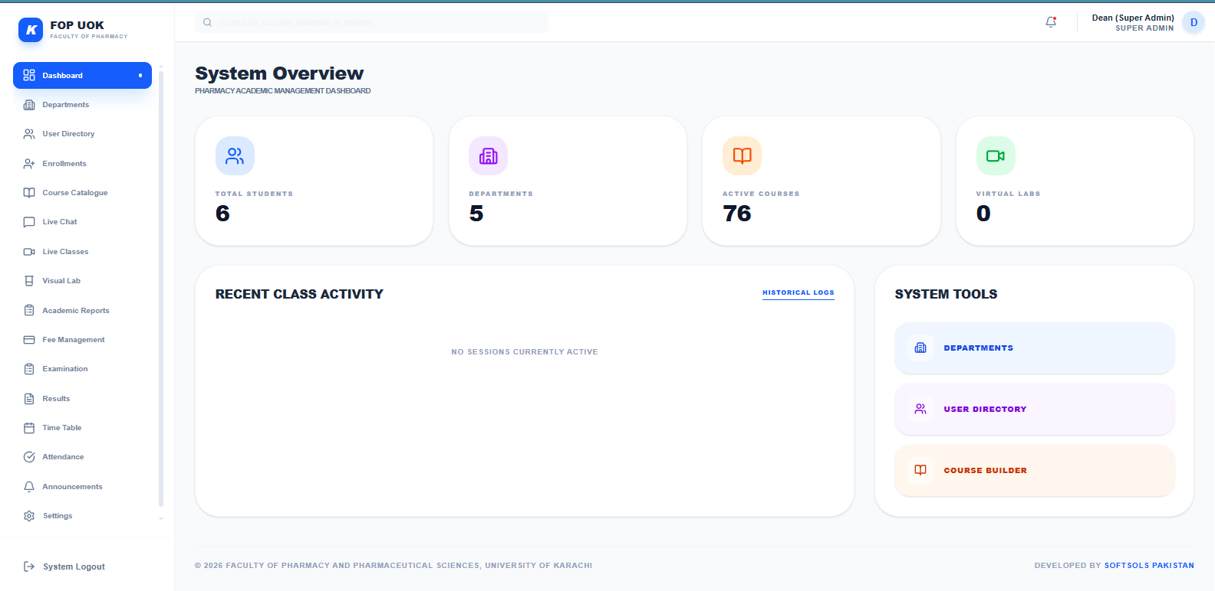
This is Dean (Super Admin) Access Dashboard and Dean has complete access of all Departments, Faculty Members, Courses and Students.
FACULTY OF PHARMACY AND PHARMACEUTICAL SCIENCES SOFTSOLS PAKISTAN

Slide 10
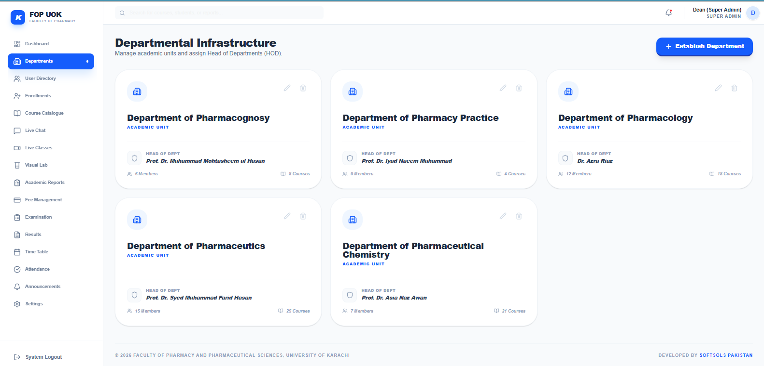
Dean can Change HOD of Any department by click Edit Button
FACULTY OF PHARMACY AND PHARMACEUTICAL SCIENCES SOFTSOLS PAKISTAN

Slide 11
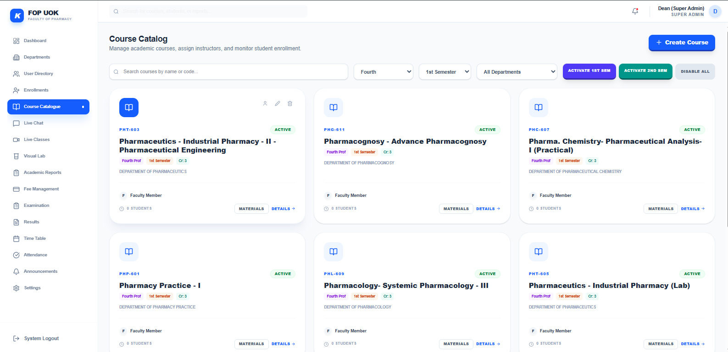
DEAN (ADMIN) CAN SET COURSES ACTIVE AS PER SEMESTER AND ALSO INDIVIDUAL COURSE.
MANAGE ALL COURSES AND ALSO ADD NEW COURSES TOO
FACULTY OF PHARMACY AND PHARMACEUTICAL SCIENCES SOFTSOLS PAKISTAN

Slide 12
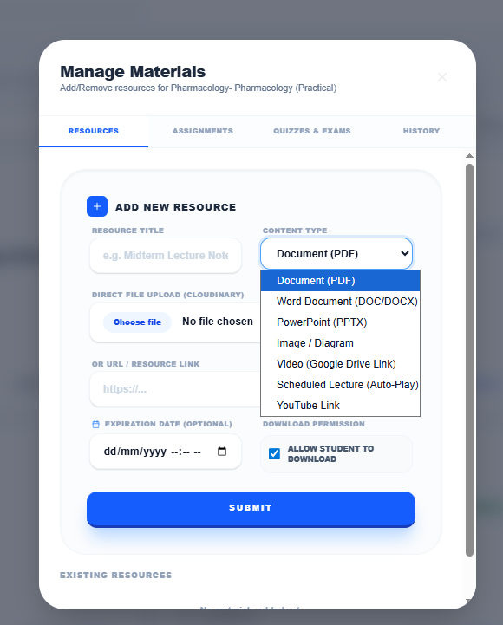
Manager Course Material
Admin / Faculty (Teacher) can manage Course Content:
Add Any Document
Add any Image
Add YouTube Video
Add Video after uploading on Google Drive and share Link here
Add Scheduled Lecture by uploading Video Lecture on Google Drive and share Link here
FACULTY OF PHARMACY AND PHARMACEUTICAL SCIENCES SOFTSOLS PAKISTAN

Slide 13
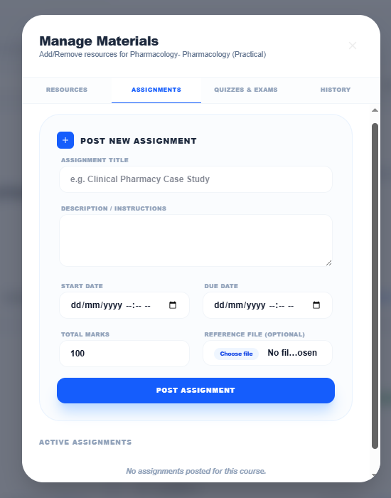
Assignment
Dean / Faculty (Teacher) can add any assignment of their course.
Option is available within Manage Material
Submission also showing alongwith assignment posted
FACULTY OF PHARMACY AND PHARMACEUTICAL SCIENCES SOFTSOLS PAKISTAN

Slide 14
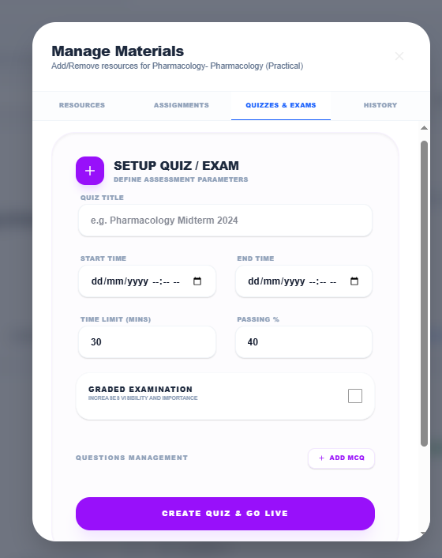
Quiz
Dean / Faculty (Teacher) can add Quiz for their Course.
The Course result will be autogenerated and will be available in Quiz and Report Section.
The Quiz is time based and is from start date/time to end date/time
The Quiz is of certain marks and Admin/Faculty (Teacher) also set passing percentage
FACULTY OF PHARMACY AND PHARMACEUTICAL SCIENCES SOFTSOLS PAKISTAN

Slide 15
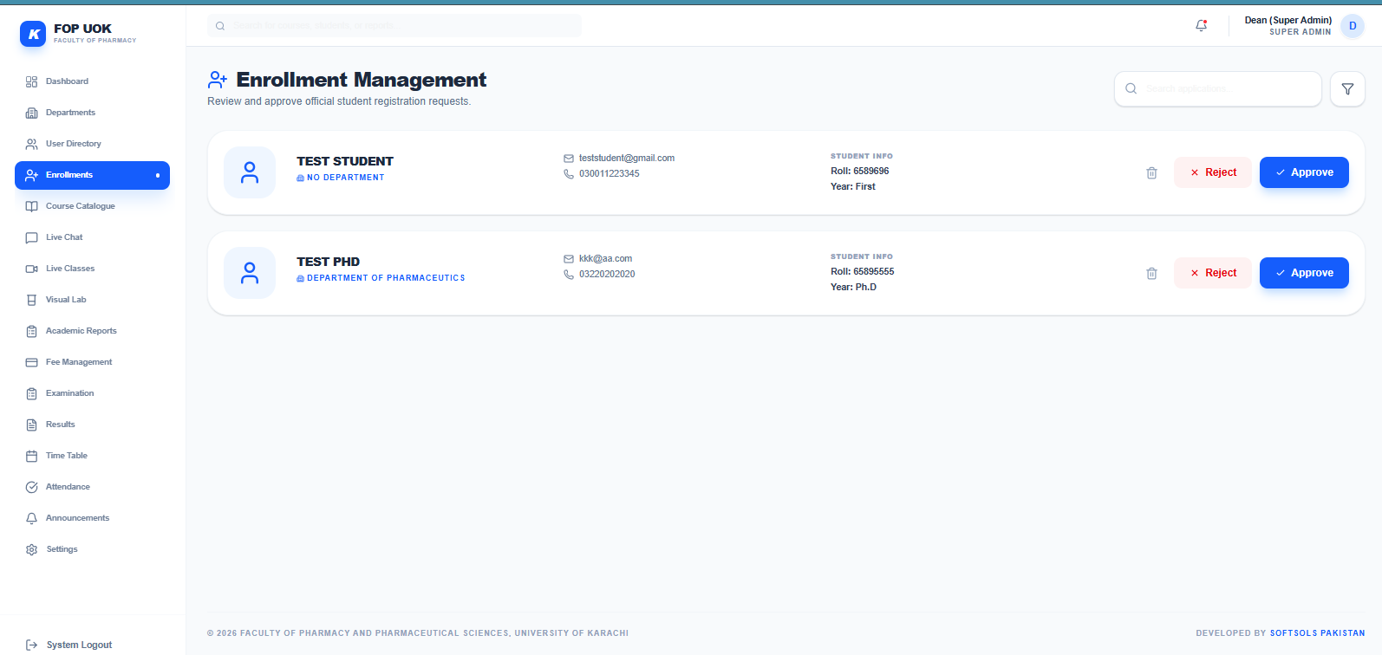
Admin and Dean Office (Sub-Admin) be able to Access Enrollment Section and can Allow Student to Access Portal after Approve the Account.
FACULTY OF PHARMACY AND PHARMACEUTICAL SCIENCES SOFTSOLS PAKISTAN

Slide 16
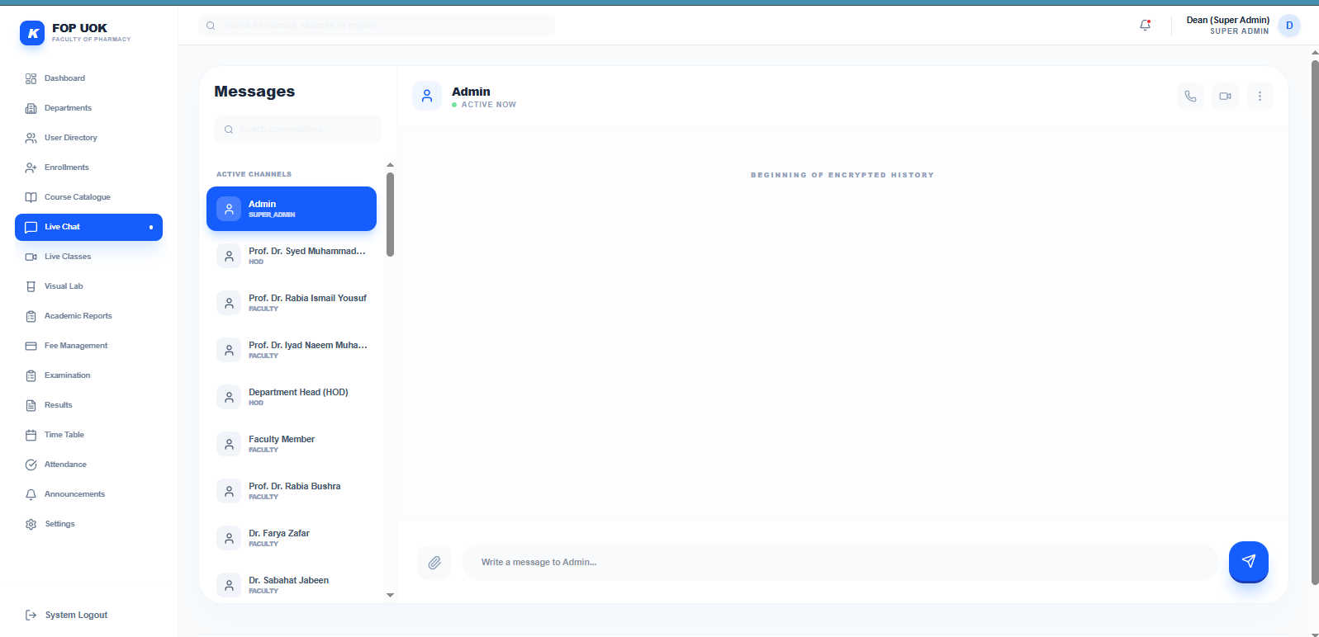
1:1 CHAT / MESSENGER between Faculty Members (Teachers), HODs, Dean Office and Dean
Any Member will send message to other.
100% Encrypted chat
FACULTY OF PHARMACY AND PHARMACEUTICAL SCIENCES SOFTSOLS PAKISTAN

Slide 17
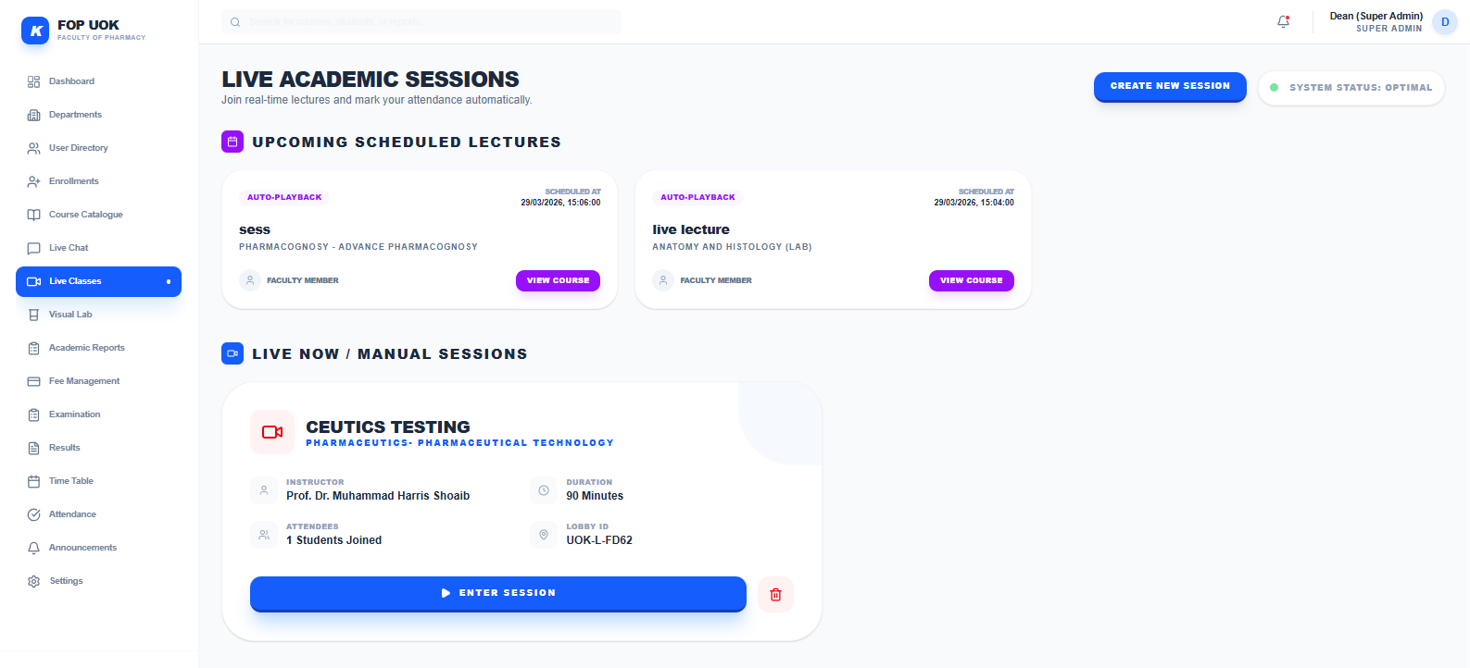
Live Classes Page showing Schedule Lectured within any Course by Admin / Teacher and also Live Session created in this Page.
FACULTY OF PHARMACY AND PHARMACEUTICAL SCIENCES SOFTSOLS PAKISTAN

Slide 18
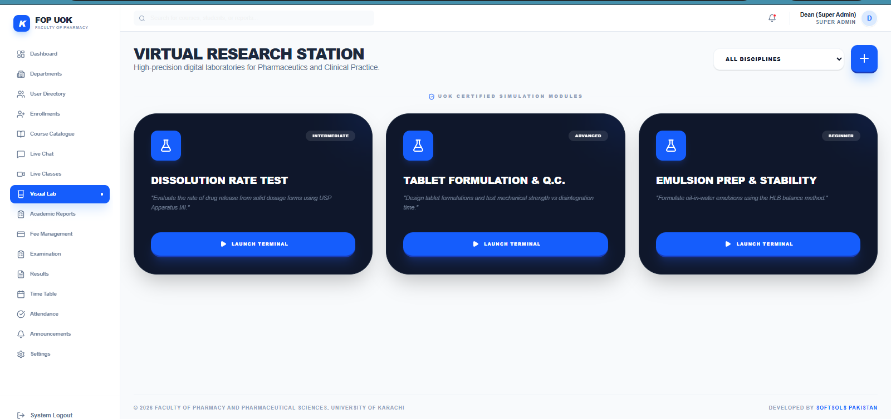
FACULTY OF PHARMACY AND PHARMACEUTICAL SCIENCES SOFTSOLS PAKISTAN

Slide 19
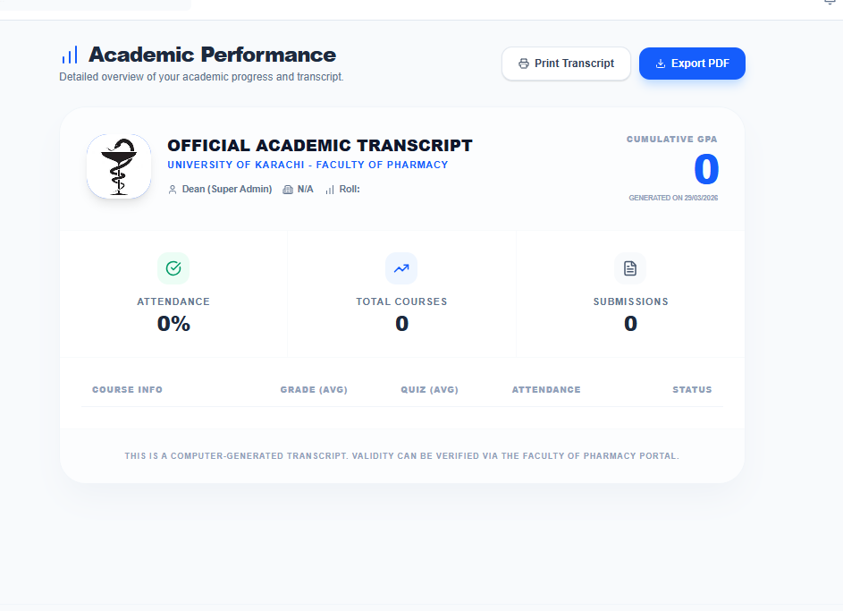
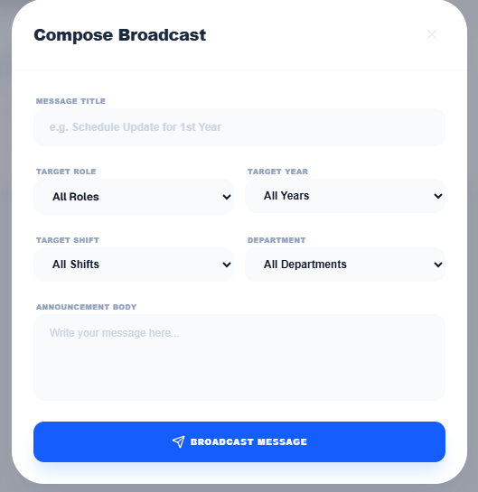
Dean (Admin) and Sub-Admin (Dean Office) will send any kind of notification to Faculty Members and Students.
Also send selected message.
FACULTY OF PHARMACY AND PHARMACEUTICAL SCIENCES SOFTSOLS PAKISTAN

Slide 20
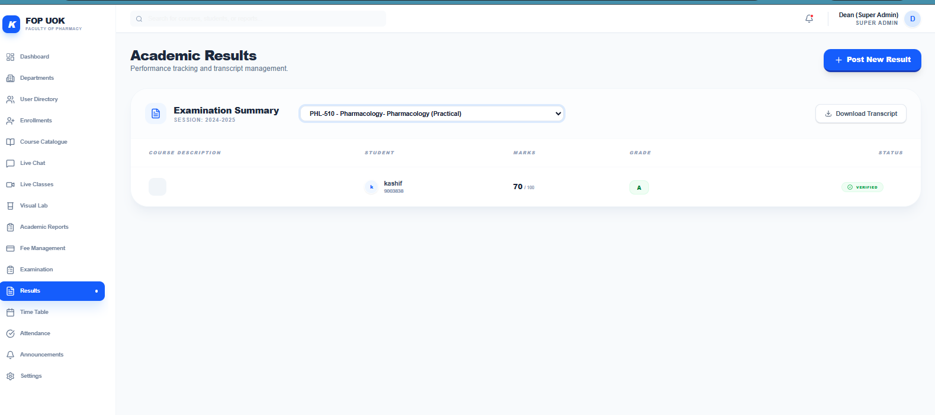
In Result Page, Teacher, HOD and Admin will be able to Post and Access Result of any Subject which will be viewable to higher hirerchy.
Like any Teacher post Result then it will be viewable to respective HOD and Dean.
FACULTY OF PHARMACY AND PHARMACEUTICAL SCIENCES SOFTSOLS PAKISTAN

Slide 21
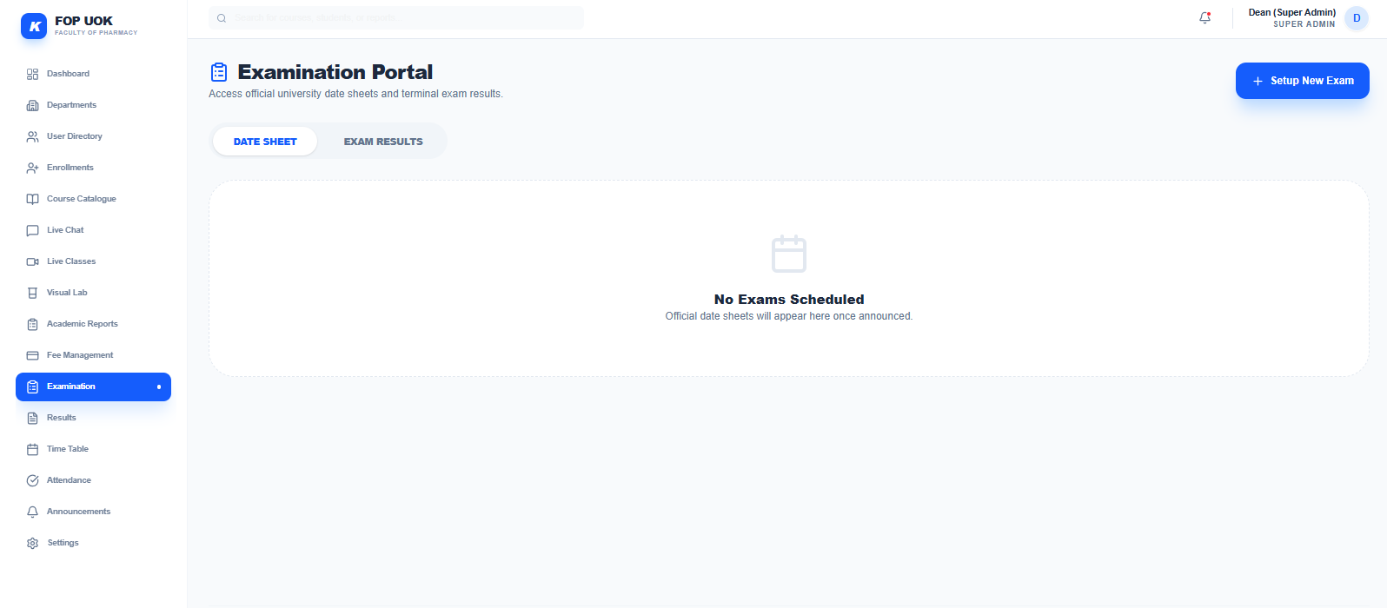
Dean Office (Sub-Admin) and Dean (Admin) able to add Examination Date Sheet and Exam Results will be added by respective Teacher
FACULTY OF PHARMACY AND PHARMACEUTICAL SCIENCES SOFTSOLS PAKISTAN

Slide 22
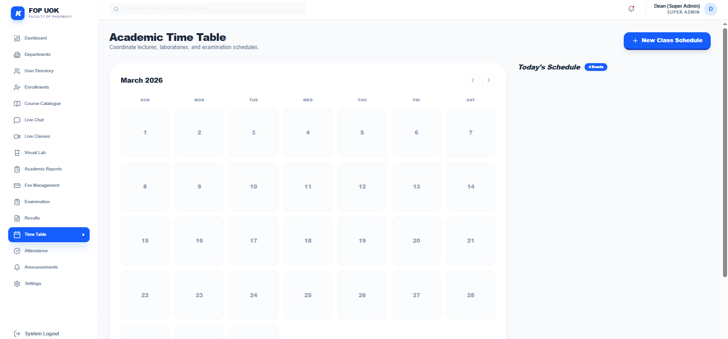
Semester Wise Time Table will be added by Dean Office and Department Head and also by Dean (Admin)
FACULTY OF PHARMACY AND PHARMACEUTICAL SCIENCES SOFTSOLS PAKISTAN

Slide 23
DEAN OFFICE (SUB-ADMIN) ACCESS
Dean Office Access Credentials are as follows:
Email: office@uok.edu.pk
Password: 123456
Dean Office able to:
APPROVE Student’s Account.
Add Time Table, Exams Sheet, Results and also send notification
FACULTY OF PHARMACY AND PHARMACEUTICAL SCIENCES SOFTSOLS PAKISTAN

Slide 24
Other Accounts Access
HODs Account
Faculty (Teachers)
Students: All 5 Years, M.Phil and PhD Students
FACULTY OF PHARMACY AND PHARMACEUTICAL SCIENCES SOFTSOLS PAKISTAN

Slide 25
FACULTY OF PHARMACY AND PHARMACEUTICAL SCIENCES SOFTSOLS PAKISTAN

Slide 26
FACULTY OF PHARMACY AND PHARMACEUTICAL SCIENCES SOFTSOLS PAKISTAN

Slide 27
FACULTY OF PHARMACY AND PHARMACEUTICAL SCIENCES SOFTSOLS PAKISTAN

Slide 28
FACULTY OF PHARMACY AND PHARMACEUTICAL SCIENCES SOFTSOLS PAKISTAN

Slide 29
FACULTY OF PHARMACY AND PHARMACEUTICAL SCIENCES SOFTSOLS PAKISTAN

